Slide 1


IoT REALIZED
CONNECTED CAR

Slide 2

Notes:
Introductions

Slide 3

CONTACT INFO
EMAIL: mminella@pivotal.io
TWITTER: @michaelminella

Slide 4


THANKS!

Slide 5

Notes:
Please ask questions when you have them

Slide 6
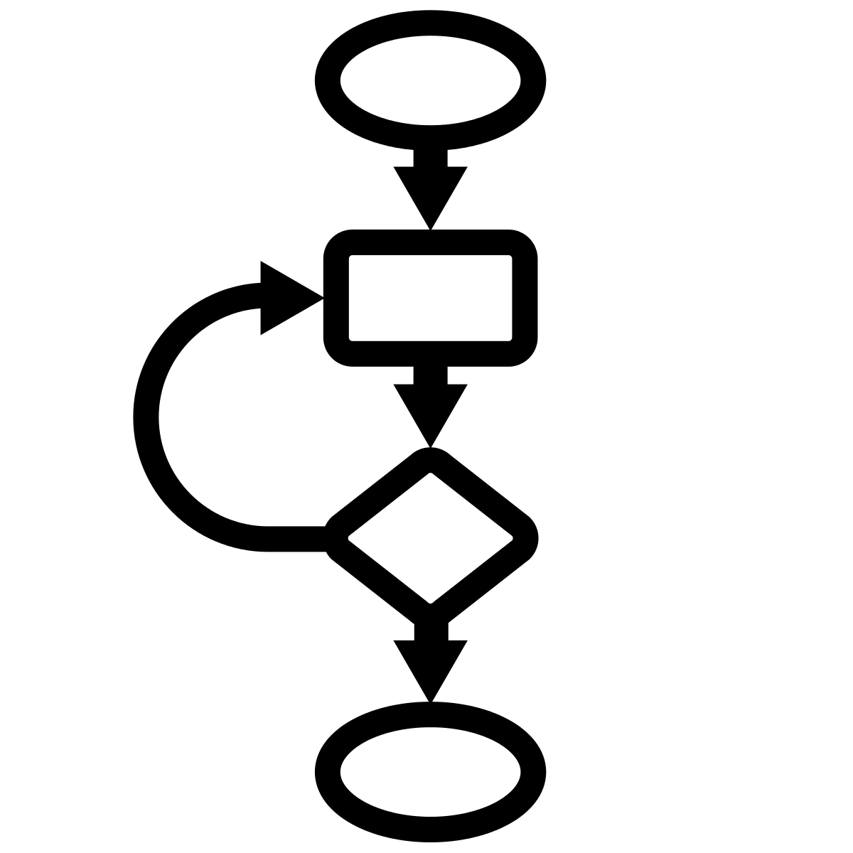

BACK TO THE
BEGINNING
Notes:
Where this talk came from

Slide 7

REALLY COOL IoT
PROJECT
Notes:
Definition of IoT
Perfect example of Pivotal Vision
Ingestion of fast data
From a large number of clients
And provide real time analytics with a dashboard

Slide 8

COVERED BY AN
NDA

Slide 9

Notes:
Ingestion of fast data
From a large number of clients
And provide real time analytics with a dashboard

Slide 10
CONNECTED
CAR

Slide 11









PIECES ARE THE
SAME
Notes:
Spring XD for ingestion
PHD/File based storage
Gemfire for “data cache”
HTML based dashboard

Slide 12

IoT IS NOT ABOUT
TWEETING APPLIANCES
Notes:
It’s not about a connected fridge (2011 Samsung introduced a tweeting fridge)
It’s about operational efficiencies…big and small
Nest on the consumer side
GE on the commercial side

Slide 13

GE Video?

Slide 14
1%
IS A
BIG DEAL
Notes:
Currently 1 billion cars worldwide
2 billion by 2035
2 billion cars = 120 million barrels of cude oil a day which =
$12 billion dollars a day in oil (Around the entire GDP of Albania)
51.6 million metric tons of CO2 per day
Removing 1% of that would be like Russia (the 4th heaviest polluter) not producing a single pound of carbon for a year
http://www.cbsnews.com/news/carbon-dioxide-emissions-rise-to-24-million-pounds-per-second/
Basic numbers for a “southwest like” situation:
314 Boeing 737’s in fleet
Each one has two CFM56 engines
Each engine requires to be pulled off for an overhaul about ever 15-20k flight hours (every 5-7 years).
Each overhaul costs around 1 million dollars including about 1,500 man hours of work.
Total number of overhauls needed per period (6 years) is 628
Reduce that by 1% means 6 million dollars savings per cyclke or about a million dollars a year.
Sources:
Southwest: http://swamedia.com/channels/Corporate-Fact-Sheet/pages/corporate-fact-sheet#fleet
Engine information: http://www.aircraft-commerce.com/sample_articles/sample_articles/maintenance_engineering_1_sample.pdf

Slide 15
CONNECTED
CAR
Notes:
2010 -> 1B cars/world
USA @ > 240mm
China growth at 27.5 year/year, China -> 1B = 2B total
120mm barrels/day (up from 87mm)
@ $100/barrel = 12B per day.
1% reduction = $120 MM per day
Not to mention the environmental impact.

Slide 16


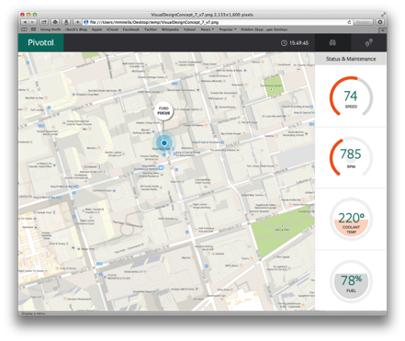


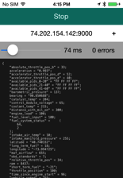

Slide 17


Slide 18

HOW DOES THIS
WORK?

Slide 19

START IN THE
CAR

Slide 20

ON BOARD DIAGNOSTICS
OBD II
Notes:
Available in every car sold in the US since 1996
Most other major auto markets have a version of OBD
Provides stats like
RPM
Speed
Mas Airflow Rate

Slide 21
01 0D
01 0D
18 DA F1 11 03 41 0D 30
>
Notes:
Mode 01
PID 0D = Speed
Yellow is the request
Blue is the full response
The orange is the echo of the request and the value in hex.
0x30 = 48 km/h = 30 mph

Slide 22
/**
* Performs the domain transformation into an acme motors specific domain model.
*
* @author gfoster
*
*/
public class AcmeMotorEnrichingTransformer implements Transformer{
@Bean
public Message<?> transform(final Message<?> message) {
final Object payload = message.getPayload();
Map<String, Object> = new HashMap<>();
try {
if (payload != null) {
map = mapper.readValue(payload.toString(), Map.class); }
map.put(“timestamp”, System.currentTimeMillis()); }
map.put(“guid”, UUID.randomUUID());
}
} catch (final Exception e) {
Notes:
Go over story about this is version 1…reverse engineering

Slide 23

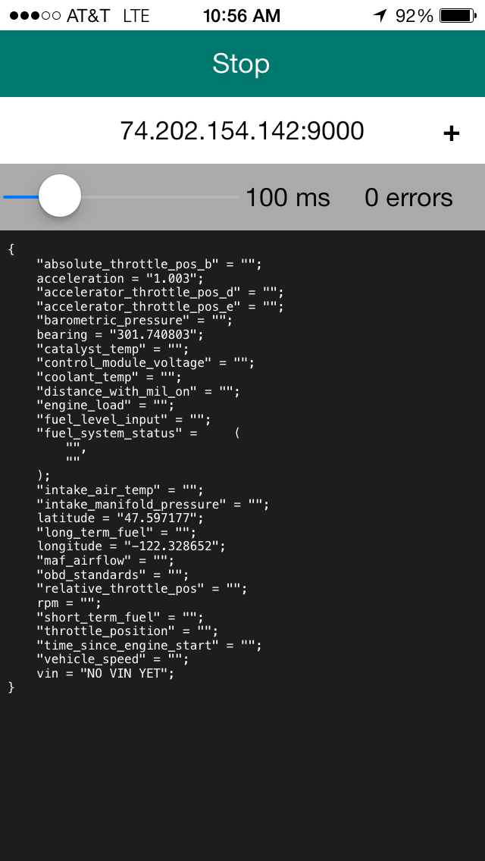
PHONE PROVIDES
CONNECTIVITY
127.0.0.1:9000
Notes:
Bluetooth to the dongle
Cellular to our server
Also enriches the data with GPS and acceleration

Slide 24
{
"vehicle_speed":103,
"obd_standards":2,
"intake_manifold_pressure":"",
"accelerator_throttle_pos_e":14,
"engine_load":89,
"maf_airflow":33,
"latitude":"32.897554",
"vin":"1HGCM82633A004352",
"bearing":"343.922580",
"catalyst_temp":779,
"relative_throttle_pos":12,
"fuel_level_input":89,
"fuel_system_status":[2,0],
"accelerator_throttle_pos_d":29,
"acceleration":"0.953",
"throttle_position":21,
"barometric_pressure":97,
"control_module_voltage":13,
"longitude":"-96.810236",
"distance_with_mil_on":0,
"coolant_temp":94,
"intake_air_temp":34,
"rpm":1593,
"short_term_fuel":-2,
"time_since_engine_start":4054,
"absolute_throttle_pos_b":38,
"long_term_fuel":3
}
Notes:
This is the Herbie JSON

Slide 25
TCP SOCKET
OVER
BLUETOOTH
HTTP POST
OVER
CELLULAR

Slide 26

ON THE
SERVER

Slide 27














IO EXECUTION
XD
IO COORDINATION
BOOT
SPRING CLOUD
Stream, Taps, Jobs
Bootable, Minimal, Ops-Ready
IO FOUNDATION
Channels, Adapters, Filters, Transformers
Jobs, Steps, Readers, Writers
BIG DATA
Controllers, REST, WebSocket
INTEGRATION
BATCH
Ingestion, Export, Orchestration, Hadoop
WEB
DATA
RELATIONAL DATA ACCESS
NON-RELATIONAL DATA ACCESS
SPRING CORE
FRAMEWORK
SECURITY
GROOVY
REACTOR

Slide 28

SPRING XD
EXTREME DATA

Slide 29

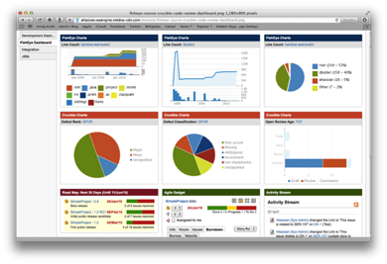





Ingestion
Orchestration
SPRING
Extraction
Real-time
Analytics
Notes:
Spring XD handles everything in the circle

Slide 30

DISTRIBUTED
RUNTIME

Slide 31


&
STREAMING
BATCH

Slide 32
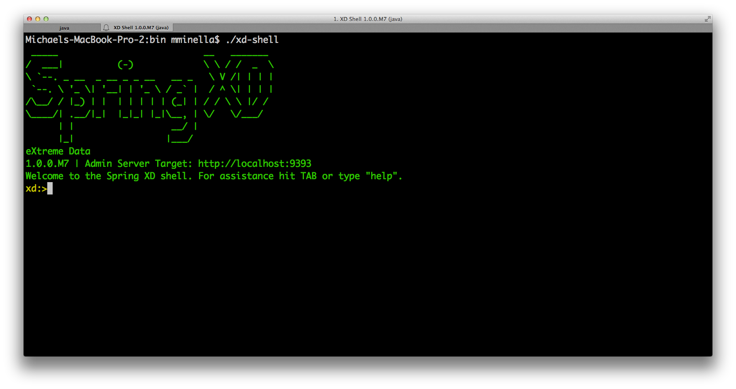

Slide 33

// Ingestion Stream Definitions
http | filter | acmeenrich | shell | hdfs

Slide 34
// Tap Definitions
IoT-HTTP.shell > typeconversiontransformer |
gemfire-server

Slide 35
TCP SOCKET
OVER
BLUETOOTH
HTTP POST
OVER
CELLULAR
Notes:
Focus on the server icon this time around

Slide 36
hdfs
Spring XD
HTTP
transformers
python
hdfs
gemfire tap
GemFire
Notes:
Transformer:
47 lines of java code
16 lines of XML
File system can be local, network, hdfs, etc.

Slide 37
/**
* Performs the domain transformation into an acme motors specific domain model.
*
* @author gfoster
*
*/
public class AcmeMotorEnrichingTransformer implements Transformer{
@Bean
public Message<?> transform(final Message<?> message) {
final Object payload = message.getPayload();
Map<String, Object> = new HashMap<>();
try {
if (payload != null) {
map = mapper.readValue(payload.toString(), Map.class); }
map.put(“timestamp”, System.currentTimeMillis()); }
map.put(“guid”, UUID.randomUUID());
}
} catch (final Exception e) {

Slide 38

REALTIME DATA
SCIENCE

Slide 39
1
PREDICT
JOURNEY

Slide 40
2
PREDICT
RANGE
Notes:
Based on journey and driving behavior

Slide 41

HOW DOES IT
WORK?
Notes:
Based on journey and driving behavior

Slide 42
STORE SENSOR
DATA
Notes:
Based on journey and driving behavior

Slide 43
OFFLINE BATCH
TRAINING
Notes:
Based on journey and driving behavior

Slide 44
INITIAL
PREDICTION
Notes:
Based on journey and driving behavior

Slide 45

REALTIME
EVALUATION
Notes:
Based on journey and driving behavior

Slide 46
…
"Predictions": {
"ClusterPredictions": {
"0": {
"EndLocation": [
32.98525175453122,
-96.70940837440399
],
"MPG_Journey": 25.60900810315203,
"Probability": 0.63736
},
…
Notes:
This is the Herbie JSON

Slide 47
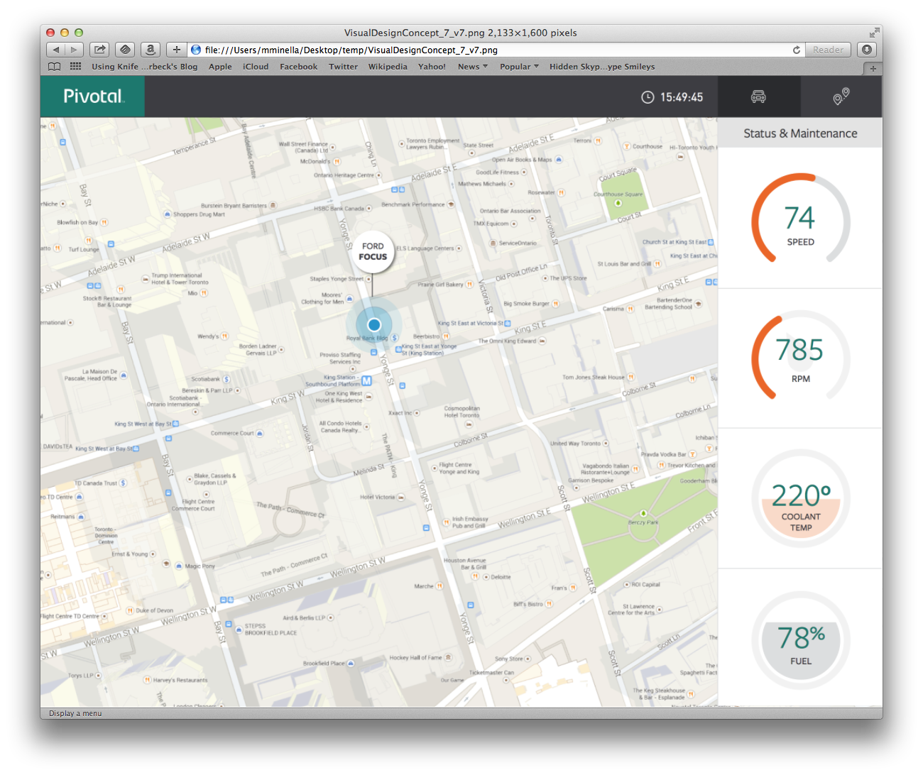
REALTIME
DASHBOARD

Slide 48
1
GEMFIRE

Slide 49
2
REST

Slide 50
3
YOEMAN

Slide 51
4
ANGULARJS

Slide 52
/**
* Performs the domain transformation into an acme motors specific domain model.
*
* @author gfoster
*
*/
public class AcmeMotorEnrichingTransformer implements Transformer{
@Bean
public Message<?> transform(final Message<?> message) {
final Object payload = message.getPayload();
Map<String, Object> = new HashMap<>();
try {
if (payload != null) {
map = mapper.readValue(payload.toString(), Map.class); }
map.put(“timestamp”, System.currentTimeMillis()); }
map.put(“guid”, UUID.randomUUID());
}
} catch (final Exception e) {
Notes:
Show REST service here

Slide 53

SOLUTION AT SCALE

Slide 54
100,000’s OF
CLIENTS
Notes:
300,000 clients (cars in our use case)?

Slide 55

MILLIONS OF
MESSAGES
Notes:
5 messages per second per client?

Slide 56

PER MINUTE OVER
100 GB
Notes:
5 messages per second per client?

Slide 57

WHAT DOES THIS
LOOK LIKE?
Notes:
5 messages per second per client?

Slide 58

Spring XD Admin
Zookeeper Cluster
hdfs
HTTP
transformers
hdfs
transformers
gemfire tap
GemFire

Slide 59

HOW DO WE MAKE IT
FASTER?

Slide 60

MAKE THE PAYLOAD
SMALLER
Notes:
No difference than the impact of gzip on web pages. Smaller packets = faster network traffic

Slide 61

PROCESS IS
I/O BOUND

Slide 62
Spring XD Admin
Zookeeper Cluster
hdfs
HTTP
transformers
hdfs
transformers
gemfire tap
GemFire

Slide 63
Spring XD Admin
Zookeeper Cluster
hdfs
HTTP | transformers | hdfs
transformers | GemFire
GemFire

Slide 64

HIGH
AVAILABILITY

Slide 65
Zookeeper Cluster
Spring XD Admin
Zookeeper Cluster
Zookeeper Cluster
hdfs
HTTP | transformers | hdfs
transformers | GemFire
HTTP | transformers | hdfs
transformers | GemFire
HTTP | transformers | hdfs
transformers | GemFire
GemFire

Slide 66

IoT
ISSUES

Slide 67

COMPATIBILITY
Notes:
Lack of consumable APIs
OBD is a good example
Each car implements their own subset of the standard
Couldn’t get VINs off some cars
Other PIDs hit or miss
Each dongle exposes underlying standard differently

Slide 68

CONNECTIVITY
Notes:
Most “things” that want to be connected don’t have their own internet access so some other device (typically a phone) is required
Different dongles used different interfaces (bluetooth vs wifi) and not all worked with all phones

Slide 69
SECURITY

Slide 70

LOOKING INTO THE
FUTURE

Slide 71


Slide 72

BATCH TRAINING IN
SPRING BATCH

Slide 73

ADDITIONAL
USE CASES

Slide 74
DRIVING
EFFICIENCY

Slide 75

TRAFFIC
PATTERNS

Slide 76

GAS
PRICING

Slide 77

ACCIDENT
ASSISTANCE

Slide 78

IoT IS
EVERYWHERE

Slide 79
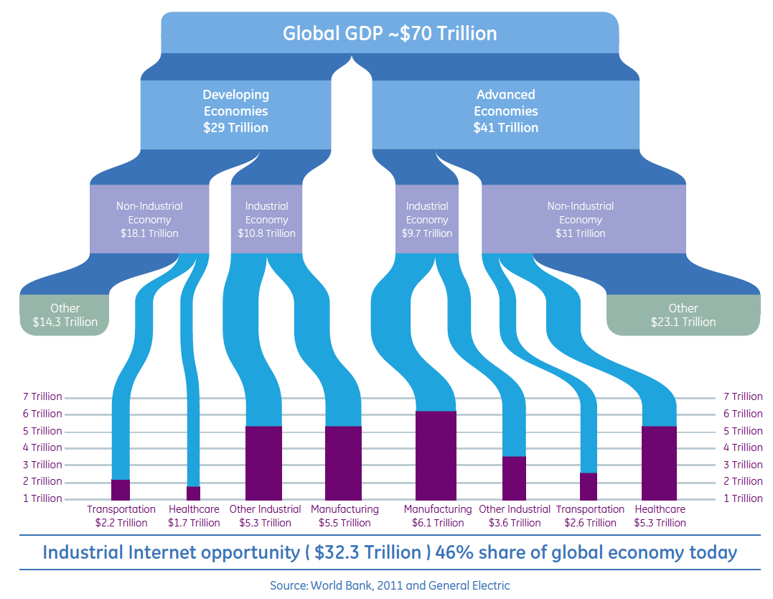

Slide 80

IoT PRESENTS UNIQUE
CHALLENGES

Slide 81

IF YOU CAN
BRIDGE THE GAPS
Notes:
5 messages per second per client?

Slide 82
SPRING XD
MAKES THE REST EASY

Slide 83


Slide 84

Learn More. Stay Connected.
Twitter: twitter.com/springcentral
YouTube: spring.io/video
LinkedIn: spring.io/linkedin
Google Plus: spring.io/gplus
Spring Framework
Project: spring.io/spring-framework
Github: github.com/spring-projects/spring-framework
Jira: jira.spring.io/browse/SPR
Spring Boot
Project: spring.io/spring-boot
Github: github.com/spring-projects/spring-boot
Spring XD
Project: spring.io/spring-xd
Github: github.com/spring-projects/spring-xd
Jira: jira.spring.io/browse/XD

Slide 85
























Connected Car by OliM
from The Noun Project
Scale by Edward Boatman
from The Noun Project
Question by Jessica Lock
from The Noun Project
Servers by Jaime Carrion
from The Noun Project
Running by Dillon Arloff
from The Noun Project
Puzzle by Matthew Hall
from The Noun Project
Sad by Austin Condiff
from The Noun Project
Happy by Austin Condiff
from The Noun Project
Nut by Naomi Atkinson
from The Noun Project
iPhone by Oleg Frolov
from The Noun Project
Plus by P.J. Onori
from The Noun Project
Erlenmeyer Flask by Emily van den Heever
from The Noun Project
Loop by useiconic.com
from The Noun Project
Square Peg Round Hole by Brady Clark
from The Noun Project
Arrows by Juan Pablo Bravo
from The Noun Project
Flow Chart by Michael Wohlwend
from The Noun Project
Network by Mister Pixel
from The Noun Project
Car Accident by Stephanie Wauters
from The Noun Project
Contract by Dimitry Baranovskiy
from The Noun Project
Thumbs Up by Alv Jørgen Bovolden
from The Noun Project
World by Janique Le Bail
from The Noun Project
Stopwatch by Scott Lewis
from The Noun Project
Puzzle by Eric M. Ellis
from The Noun Project
Thinking by Jens Tärning
from The Noun Project
Clock by Nick Green
from The Noun Project
Database by Anton Outkine
from The Noun Project
Refridgerator by Rohan Gupta
from The Noun Project
Car by Laura Beggs
from The Noun Project
Car Accident by Stephanie Wauters
from The Noun Project
Error by Dmitry Baranovskiy
from The Noun Project
Blueprint by Dimitry Sokolov
from The Noun Project
Hard Drive by Mike Wirth
from The Noun Project
Fuel by Yair Cohen
from The Noun Project

Slide 86

The
End

